Slide 1
Getting Started in
Public Speaking
Tso, Wei-fung
National Taipei University

Slide 2
Outline
The importance of Public Speaking
The Speaking Situation & Speech Purpose
Organizing a Speech
--Outling
--Sequencing & Linking Information
Introduction & Conclusion
PPT Layout and Graphs
Nonverbal Delivery

Slide 3
The Importance of Public Speaking
“ The Last Mile”
Opportunities and Risks
“Nothing ventured; nothing gained.”

Slide 4
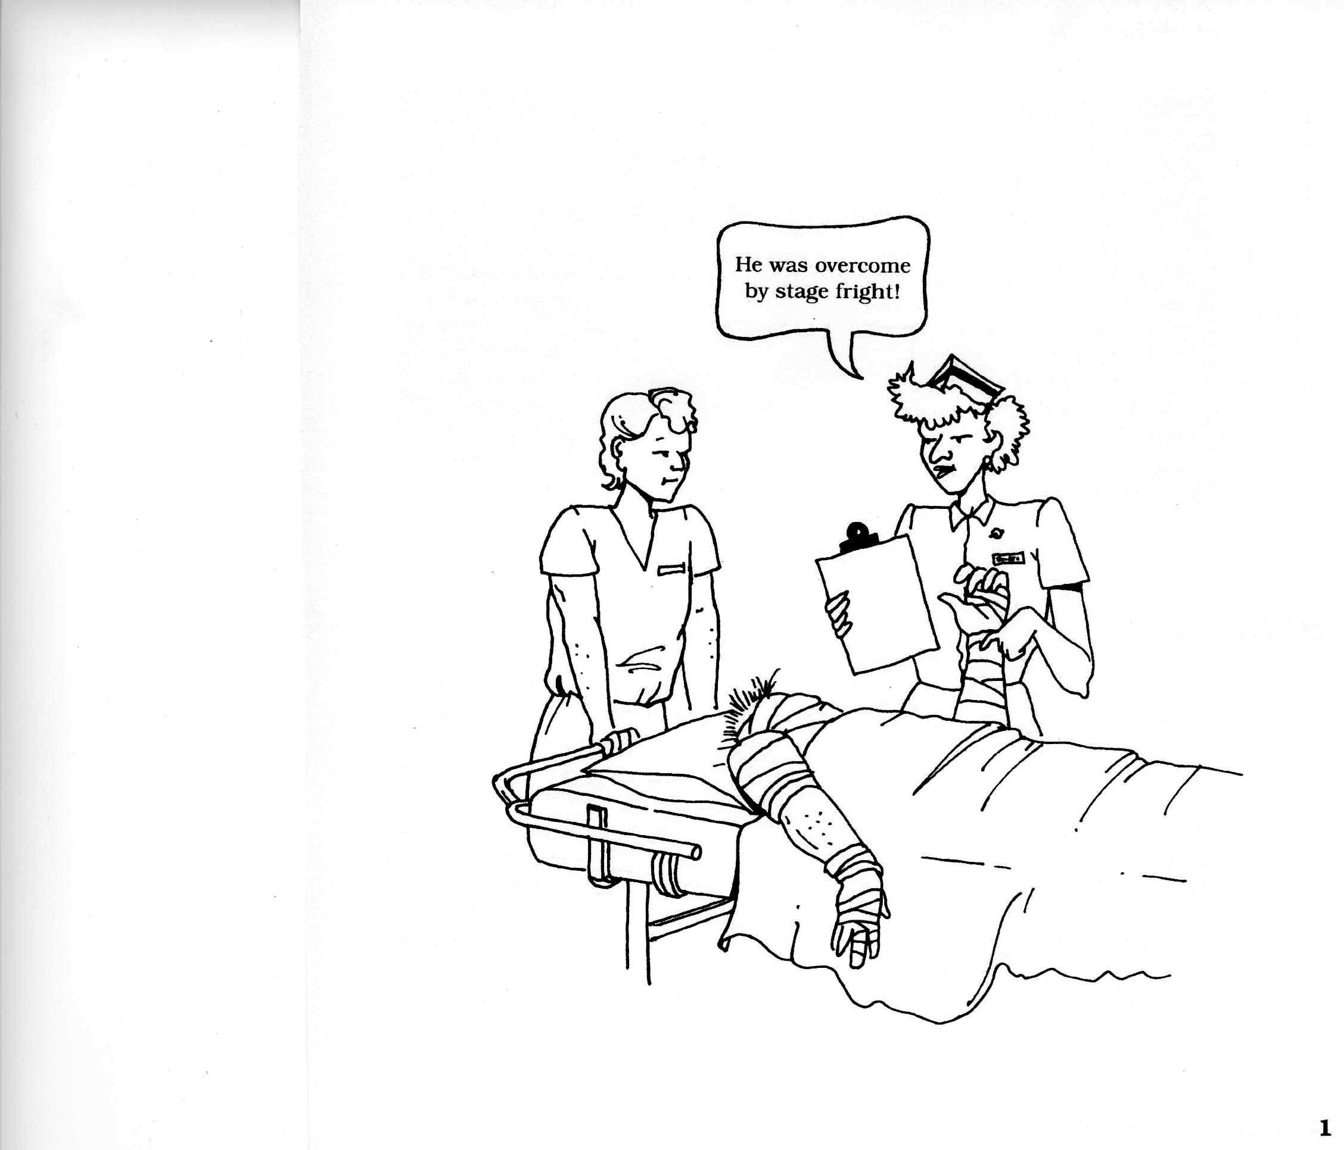
Stage Fright

Slide 5
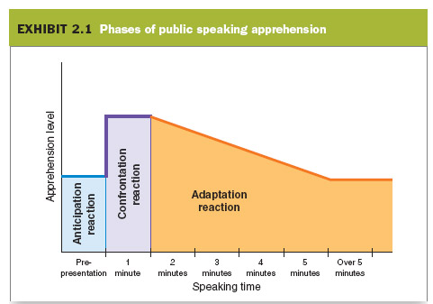
Phases of Public Speaking Apprehension
Anticipation reaction
Confrontation reaction
Adaptation reaction

Slide 6
How to cope with stage fright?
Everyone feels the same.
Choose a comfortable subject.
You know more about the topic.
You have important information and opinions.
The opportunities outweigh the risks.
Practice makes perfect.

Slide 7
The Speaking Situation

Slide 8
YOU
YOUR AUDIENCE
THE OCCASION

Slide 9
Speech Purpose

Slide 10
Speech Purpose
Who Where
What Why
When How
To Entertain
I want to convince
my audience that…
Is, Was, Will be
Must, Should
The purpose of this speech is to give a humorous review of the swimming season for team members and fans.
To Inform
The purpose of this speech is to update the new students on recent changes in school rules and policies.
To Persuade
The purpose of this speech is to convince the club members that selling calendars is a good way to raise money.

Slide 11

Identifying Speech Purpose:
The purpose of this speech is to tell students how to apply for a job.
The goal of this speech is to convince the school board to purchase new computers for the language lab.
The purpose of this speech is to talk about dancing.

Slide 12
Organizing a Speech

Slide 13
Organizing A Speech
Selecting an organizational pattern
Outlining the content
Preparing the transitions
Introduction
Body
Conclusion

Slide 14
Organizational Patterns
Logical or Topical Order
I. Physical benefits
A. Cardiovascular strength
B. Muscle tone
C. Weight loss
II. Mental benefits
A. You are more alert
B. You feel better about yourself
Chronological Order

Slide 15
Organizational Patterns
Spatial Order
Classification
Cause-Effect Order
Multiple Patterns
Chronological
sequence
Classification
Logical
sequence
History of street dancing
  Development of street dancing in the South Bronx
  Popularization through movies
Types of street dancing
  Breaking
  Electric Boogie
Why is street dancing so popular?
  It is a form of recreation
  It is a nonviolent way of setting scores
  It provides entertainment for viewers

Slide 16
Structure the Body of Your Speech
Introduction
Main Body of Information
First Part
--a
--b
--c
--d
Second
Part
--a
--b
--c
Third Part
--a
--b

Slide 17
Rules of Outling
Use standard subordination
Major point
A. Subpoint
1. Example (subdivision of subpoint)
a. Additional example or explanation
(1) Additional explanation
(a) Additional explanation
Use one statement per unit of subordination
Wrong: A. Breaking and electric boogie are two forms of street dancing.
Right: A. Breaking is one form of street dancing.
B. Electric boogie is another form.

Slide 18
Do not overlap items
Wrong: A. Parents are affected
B. People with no children are afffected
C. Married people are affected
Right: A. Parents are affected
1. Married parents
2. Single parents
B. People with no children are affected
1. Married individuals
2. Single individuals
Give equal value to ideas on the same level of subordination
Wrong: A. Major industries are affected by imported cars
1. Shipping
2. Steel
3. Ford Motor Company
Right: A. Major industries are affected by imported cars
1. Shipping
2. Steel
3. Automobile

Slide 19
Outlining activity
Three steps required to shoot a jump shot:
Square yourself to the basket.
Face the basket with ball in hand.
Make Sure that the line of your shoulder is perpendicular to the line to the basket.
Balance yourself.
Your feet should be spread comfortably.
The foot on the side of your shooting hand should be slightly ahead of the other.
Deliver the ball smoothly.
The ball should be resting in the palm of your shooting hand.
Your eyes should be on a spot just over the rim.
Jump vertically.
At the highest point of the jump, push the ball in an arc.
Follow through with your shooting hand.

Slide 20
Outlining activity
Three steps required to shoot a jump shot:
I. Square yourself to the basket.
A. Face the basket with ball in hand.
B. Make Sure that the line of your shoulder is perpendicular to the line to the basket.
II. Balance yourself.
A. Your feet should be spread comfortably.
B. The foot on the side of your shooting hand should be slightly ahead of the other.
III. Deliver the ball smoothly.
A. The ball should be resting in the palm of your shooting hand.
B. Your eyes should be on a spot just over the rim.
C. Jump vertically.
D. At the highest point of the jump, push the ball in an arc.
E. Follow through with your shooting hand.

Slide 21
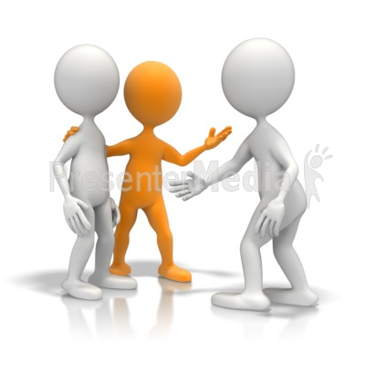
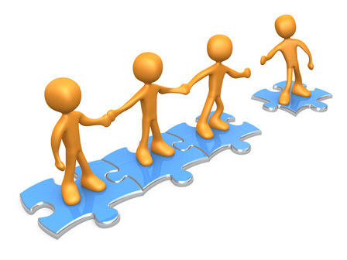
Transitions

Slide 22
Sequencing & Linking Information
Signaling the different parts of the presentation
Match:
1. First… a) Now we come to…
2. Then… b) I’ve finished talking about…
3. Finally… c) To begin with…
4. That’s all on… d) After that…
5. Now let’s turn to… e) Lastly…

Slide 23
Sequencing & Linking Information—cont.
Listing and Sequencing
There are _____ things to talk about. The _____
is design. The _____ is design. The _____ is
quality. Then the _____ one is communication.
three
first
last
second
then
one
third
another
several
I think there’re _____ problems to address.
_____ is competition. _____ is customer needs.
_____ the _____ issue is marketing.

Slide 24
Sequencing & Linking Information—cont.
Linking
That _____ the introduction. Let’s _____ now at the first part.
That’s _____ on the theory. Now we _____ to the practice.
Now that I’ve _____ the background. _____ look next at the present situation.
_____ this then, we _____ to the next part. This is about money.
concludes
look
move/go
all
finished/introduced
Let’s
After
continue

Slide 25
Linking—cont.
5. So that’s the _____ of the main part of my talk. I’d like to _____ on to the conclusion.
6. I’ve _____ talking about the home market. _____ I’d like to _____ on to talk about the overseas market.
end
move
finished
Next/Now
move

Slide 26
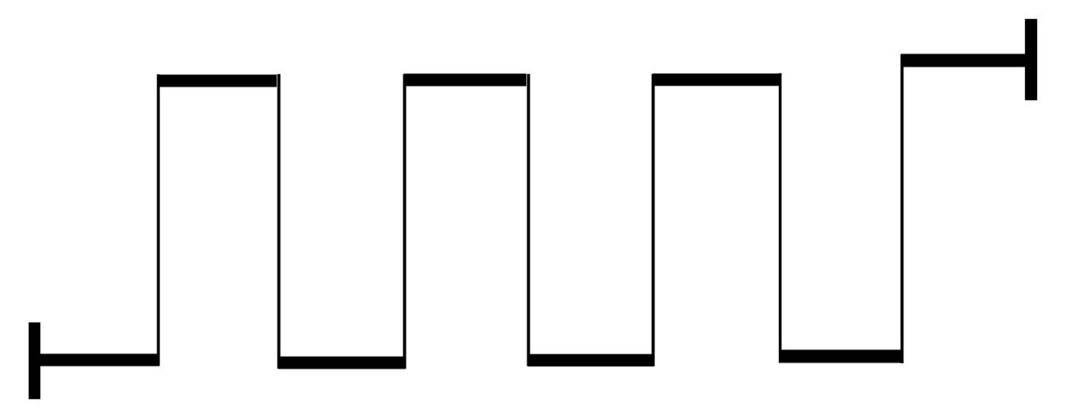
The pattern

Slide 27



What
could be
What
could be
What
could be
New bliss
The
gap
What is
What is
What is
What is

Slide 28

The pattern of Martin Luther King’s speech

Slide 29

“American has given the Negro people a back check, a check which has come back marked insufficient funds.”
“So we have to come to cash this check, a check that will give us upon demand the riches of freedom and security of justice.”

Slide 30

that one day this nation will rise up and live out the meaning of its creed. We hold these truths to be self-evident, that all men are created equal.
that one day…
that one day…
I have a dream…
I have a dream…
I have a dream…

Slide 31

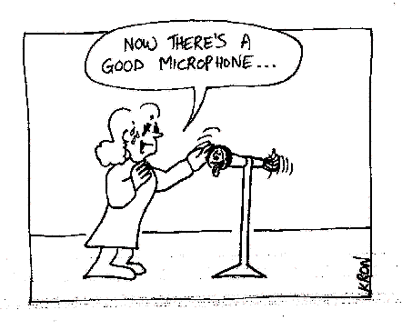

Slide 32


Slide 33
Outline
Introduction & Conclusion
PPT Layout and Graphs
Other Visual Aids
Nonverbal Delivery
The Presentation Day

Slide 34
Introduction & Conclusion

Slide 35
Introduction
Quotation
President John F. Kennedy once said, “The United States must move very fast to even stand still.” Since President Kennedy made that observation over twenty years ago, the advances in technology have made it even more important for this country to prepare its students for a competitive world.

Slide 36
Introduction—cont.
Rhetorical Question
How lucky are we here today to be at this great location? Is there anything better than getting a day off from work to come listen to a speech?

Slide 37
Introduction—cont.
Personal and historical references
historical references
Forty years ago when I graduatged from high school, the world was a different place than it is for graduates today. Computers had not taken over the world. Students did not live in fear of the world ending in nuclear disaster.
Five score years ago, a great American, in whose symbolic shadow we stand today, signed the Emancipation Proclamation.

Slide 38
Introduction—cont.
Humor
Many of us have enjoyed steak and eggs for breakfast. But have we ever thought about the roles of the chicken and the steer in our breakfast? They aren‘t the same. The chicken was involved, but the steer was definitely committed to feeding us! Often our commitment is more like the chicken‘s—we are involved in the process, but not really committed all the way.

Slide 39
Introduction—cont.
Startling Statement
Stop! Before you take another bite out of a peanut butter and jelly sandwich, think about the fact that it may be slowly killing you. How? Simple. There is a natural substance in peanuts known as aflatoxin that could cause cancer. But then, you ask, what in our food doesn‘t cause cancer?

Slide 40
Introduction—cont.
Incident
Last week a young boy was hovering near death in a hospital room across town. As his parents prepared to accept the fact their son would be with them only a few more hours, they made a decision which would help him live on. They decided to donate their son‘s organs so that others might live or at least live fuller lives. Today, two individuals are recipients of kidneys which will free them from dialysis machines, a woman is on her way to seeing again, and a young child will receive a liver which will save her from a rare disease.

Slide 41
Conclusion
Inform the audience you are about to close
Summarize the major ideas
Leave the audience with an idea to remember
So next time you volunteer for a project or set a personal goal, think about the chicken and the steer. Are you going to be involved but give little of yourself, or are you going to be committed and give it everything you have? Success or failure can be the difference.

Slide 42
PPT Layout & Graphs

Slide 43
PPT Layout
Font size and style
English Presentation Skills (20)
English Presentation Skills (28)
English Presentation Skills (32)
English Presentation Skills
No more than 3(4) Colors on one page
PPT Sample
..\Documents\Speech\Visual Aids\葉力禎 visual aid-Login_in_Facebook.ppt

Slide 44
Country of Origin of U.S. Latinos
Source: By the author. Based on Statistical Abstract 2005: Table 40

Slide 45
Hours of Housework per Week
Source: Based on Stapinsky, American Demographics, vol. 20, no. 11 (November 1998)

Slide 46
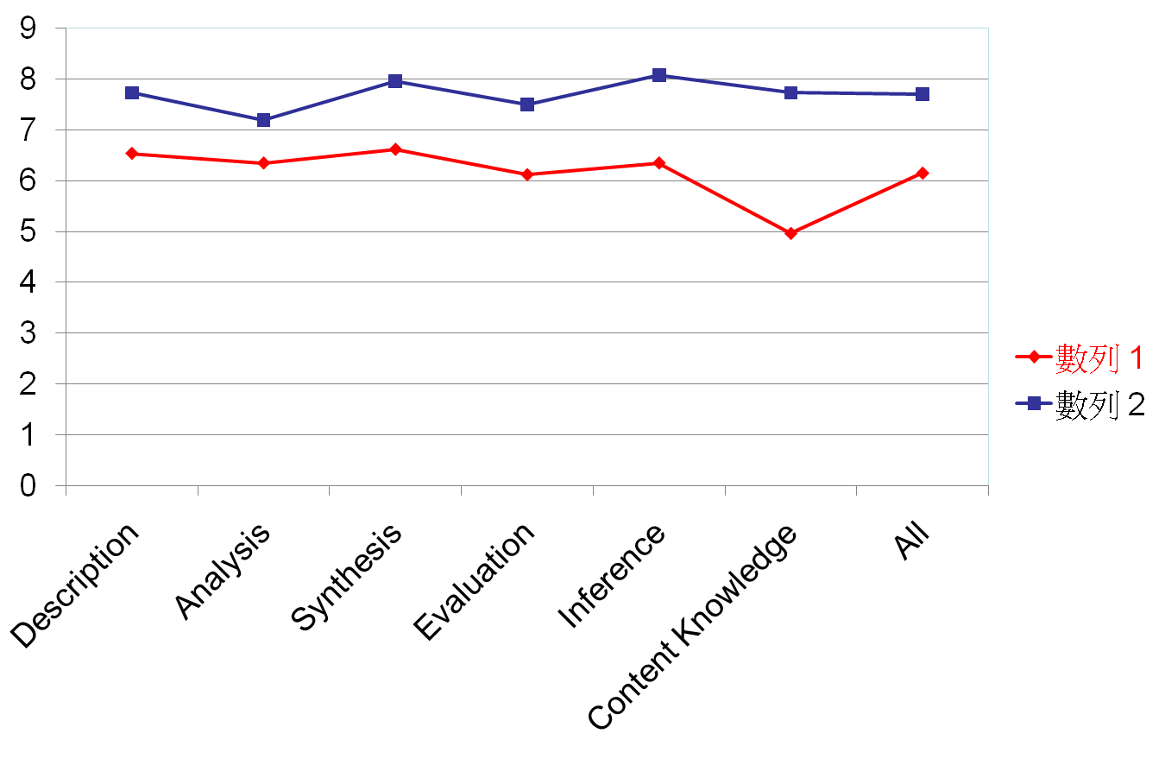
Line Graph of the Group’s Pre- & Post Tests

Slide 47
Characteristics of
Resume Writing
Methodology
Students’
Errors
Results and Discussion
Conclusion and
Implication
Error Type | subtotal | % of total (416) | Error Type | subtotal | % of total (416)
FORMAT | 76 | 18% | LANGUAGE | 198 | 48%
Dates | 32 | 7.7% | Collocation | 46 | 11%
Name and contact information | 25 | 6% | Awkward English | 45 | 10.8%
Chronological order | 7 | 1.7% | Vocabulary | 29 | 7%
Alignment | 7 | 1.7% | Wordiness | 23 | 5.5%
Others | 5 | 1.2% | Grammar | 23 | 5.5%
CONTENT | 105 | 25% | Word choice | 20 | 4.8%
Completeness | 54 | 12.9% | Abbreviations | 12 | 2.9%
Generality | 23 | 5.5% | MECHANICS | 22 | 5%
Organization | 15 | 3.6% | OTHERS | 15 | 4%
Relevance | 8 | 1.9%
Others | 5 | 1.2%

Slide 48
PPT Sample
F:\Speech\Visual Aids\葉力禎 visual aid-Login_in_Facebook.ppt

Slide 49
Other Visual Aids
Handouts
Pictures
Videos
Models

Slide 50
Nonverbal Delivery

Slide 51
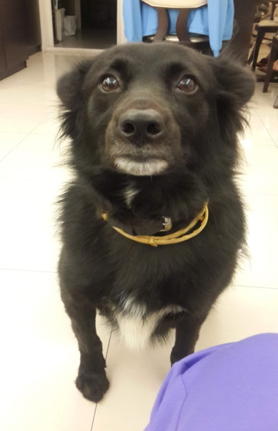
Confidence Scale
C
O
N
F
I
D
E
N
C
E
COMPASSION

Slide 52
Nonverbal Delivery
Posture and stance
Gestures
Eye contact
Facial expressions
Appearance

Slide 53
The Voice

Slide 54
The Voice:
Volume
Was my speech loud enough to be heard?
Did I vary my volume to express emotion, emphasis, etc.?
Rate
Did I vary my rate to suit the meaning of the speech?
Did I use pauses effectively?
Did I frame important words?

Slide 55
The Voice:
Pitch
Did my voice vary in pitch, or was it monotonous?
Pronunciation
Did I know how to pronounce all the words?
Enunciation
Were the words enunciated clearly?

Slide 56
Using volume to express emphasis or “punching”:
I saw the game.
I saw the game.
I saw the game.
I saw the game.
The photographer took my picture.
The photographer took my picture.
The photographer took my picture.

Slide 57
Using rate to build effects:
Rats!
They fought the dogs and killed the cats,
And bit the babies in the cradles,
And ate the cheeses out of the vats,
And licked the soup from the cooks’ own ladles,
Split open the kegs of salted sprats,
Made nests inside men’s Sunday hats,
And even spoiled the women’s chats
By drowning their speaking
With shrieking and squeaking
In fifty different sharps and flats

Slide 58
Using pause for “framing”:
You’ve given me the most precious gift I’ve ever received—friendship.
The jeweler said he would put the bracelet aside for me for a slight fee.
To a real student this assignment offers many challenges.

Slide 59
Using pitch variation to indicate meaning:
Me (Are you talking to me?)
Me (I didn‘t do it.)
Me (I‘ll do it.)
Four dollars (Is that all?)
Four dollars (That‘s what it costs)
Four dollars (not five)

Slide 60
The Presentation Day
Venue:
upload PPT
laser pointer
Dress code
Team work

Slide 61
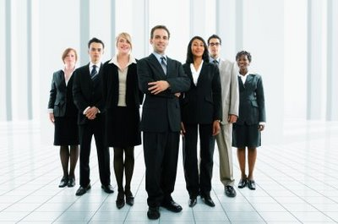
Dress Code

Slide 62

In Conclusion
“Luck is what happens when preparation meets opportunity.”

