Slide 1
Unity註冊及安裝

Slide 2
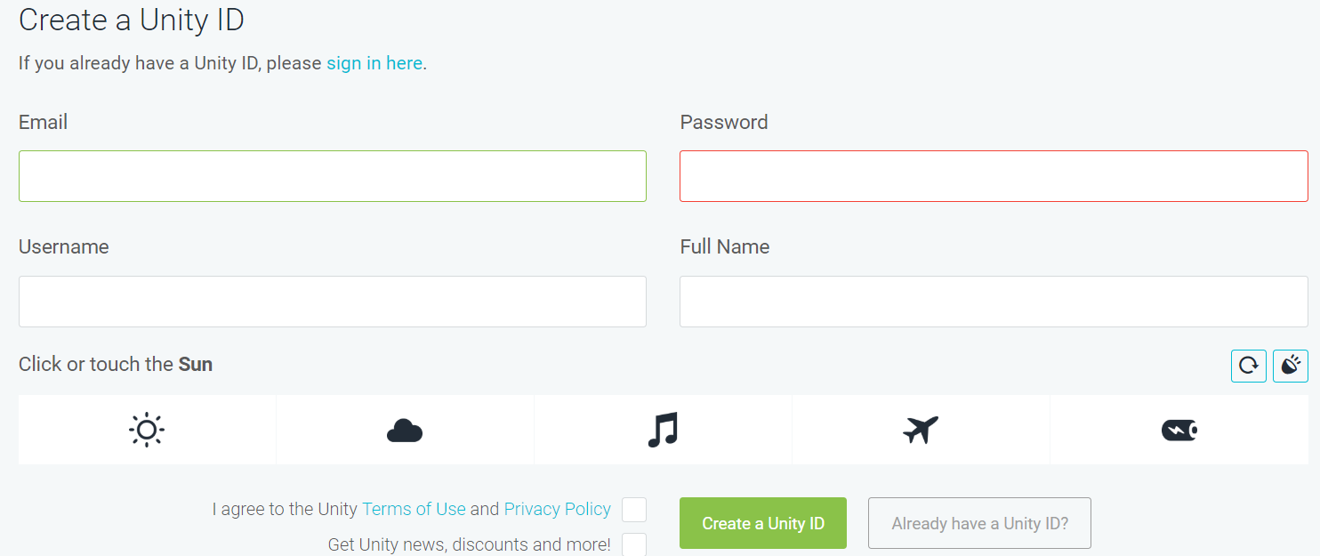
註冊
官網首頁 https://unity3d.com/
註冊頁面https://id.unity.com/en/conversations/7ea52c15-5d71-43c2-bec2-6bf5bf802481010f

Slide 3
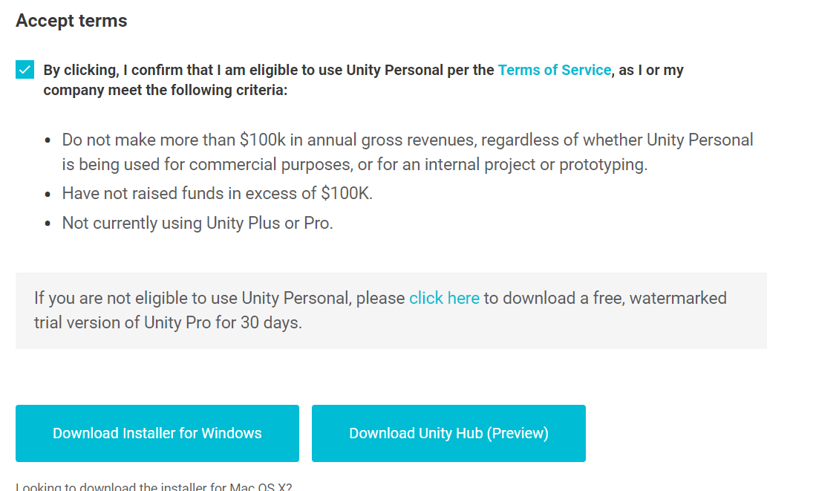
安裝(64位元)
https://store.unity.com/download?ref=personal
勾選同意後下載安裝

Slide 4
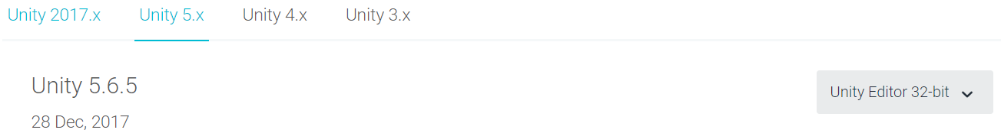
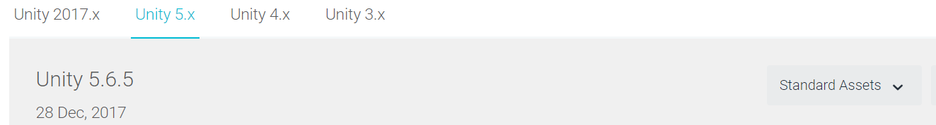
安裝(32位元)
https://unity3d.com/get-unity/download/archive
需下載兩個並安裝

